Slide 1
The Elevator “Journey to the Third Floor”

Slide 2
Outlining of The Presentation
How did we tackle the project?
Software Phase
Hardware Phase
Testing Phase
Photo Album
Received Benefits

Slide 3
Temperature Sensor
Bump Sensors
DC Fan
Tackling the Project:
1. Buying the Equipment
LED
CD-ROMS (Doors)
Pulley
Push
Buttons
Rope
Wood (A Lot of it)
Connecting Wires
Motor
Camera

Slide 4
ran
gig
in
Oz
O
r
g
a
n
i
z
i
n
g

Slide 5
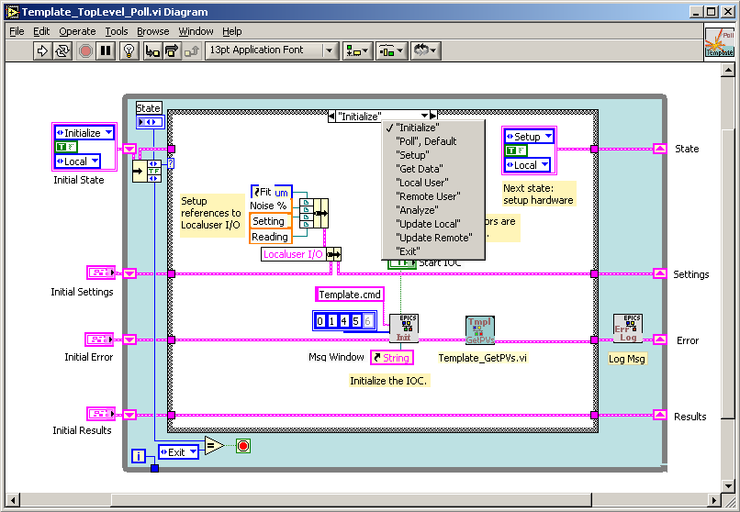
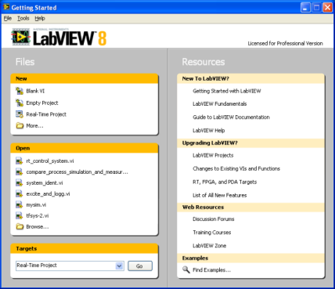
Software Phase
Output: What inputs?

Slide 6
Calls: L1,L2,L3
DISP0 | DISP1 | P1 | F1 | L1 | P2 | F2 | L2 | P3 | F3 | L3
0 | 1 | 1 | 1 | 0 | 1 | 1 | 1 | 1 | 1 | 1
0 | 1 | 1 | 0 | 0 | 1 | 0 | 1 | 1 | 0 | 1
0 | 1 | 0 | 1 | 0 | 0 | 1 | 1 | 0 | 1 | 1
0 | 1 | 0 | 0 | 0 | 0 | 0 | 1 | 0 | 0 | 1
1 | 0 | 1 | 1 | 1 | 1 | 1 | 0 | 1 | 1 | 1
1 | 0 | 1 | 0 | 1 | 1 | 0 | 0 | 1 | 0 | 1
1 | 0 | 0 | 1 | 1 | 0 | 1 | 0 | 0 | 1 | 1
1 | 0 | 0 | 0 | 1 | 0 | 0 | 0 | 0 | 0 | 1
1 | 1 | 1 | 1 | 1 | 1 | 1 | 1 | 1 | 1 | 0
1 | 1 | 1 | 0 | 1 | 1 | 0 | 1 | 1 | 0 | 0
1 | 1 | 0 | 1 | 1 | 0 | 1 | 1 | 0 | 1 | 0
1 | 1 | 0 | 0 | 1 | 0 | 0 | 1 | 0 | 0 | 0

Slide 7
Motor
L1 | L2 | L3 | S1 | S2 | S3 | motor
1 | 0 | 0 | 1 | 0 | 0 | 0
1 | 0 | 0 | 0 | 1 | 0 | 1
1 | 0 | 0 | 0 | 0 | 1 | 1
0 | 1 | 0 | 1 | 0 | 0 | 1
0 | 1 | 0 | 0 | 1 | 0 | 0
0 | 1 | 0 | 0 | 0 | 1 | 1
0 | 0 | 1 | 1 | 0 | 0 | 1
0 | 0 | 1 | 0 | 1 | 0 | 1
0 | 0 | 1 | 0 | 0 | 1 | 0

Slide 8
Display
S1 | S2 | S3 | DISP0 | DISP1
1 | 0 | 0 | 0 | 1
0 | 1 | 0 | 1 | 0
0 | 0 | 1 | 1 | 1
Sensors are on one at a time

Slide 9
Motor Direction
DISP0 | DISP1 | L2 | L3 | MD
1 | 0 | 1 | 1 | 1
1 | 0 | 1 | 0 | 0
1 | 0 | 0 | 1 | 1
1 | 0 | 0 | 0 | 0
0 | 1 | 1 | 1 | 1
0 | 1 | 1 | 0 | 1
0 | 1 | 0 | 1 | 1
0 | 1 | 0 | 0 | 0
Motor Direction is on when elevator moves upward
Hence, when L1 is called elevator moves down, and when position is third floor, elevator will ove down when called.

Slide 10
Doors
Close after 7 seconds if doorway is empty (using tick counter as suggested)
Depends upon: Door sensor, DISP0, DISP1, L1,L2,L3.

Slide 11
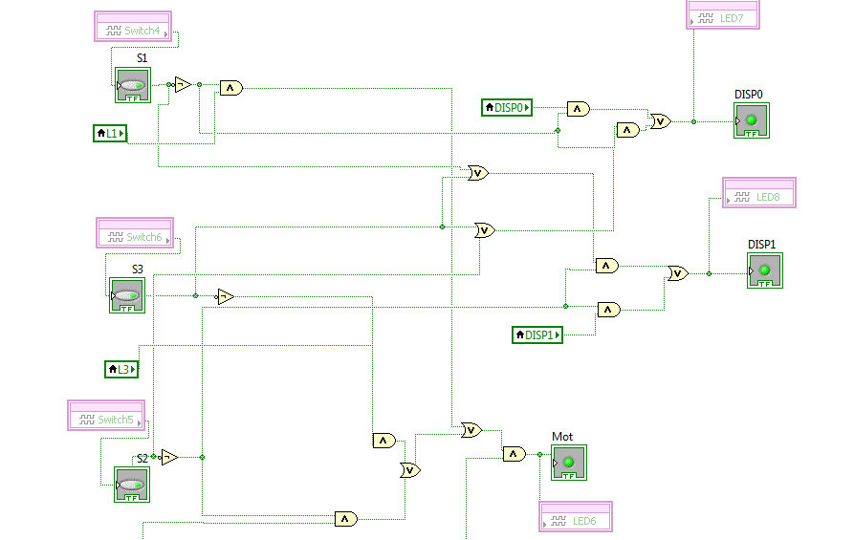
Software Snapshots

Slide 12
Hardware

Slide 13
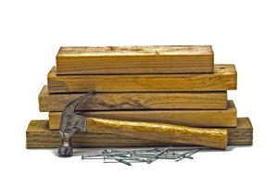
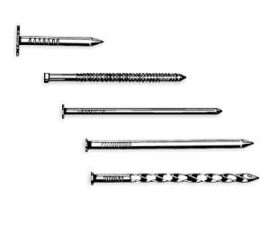
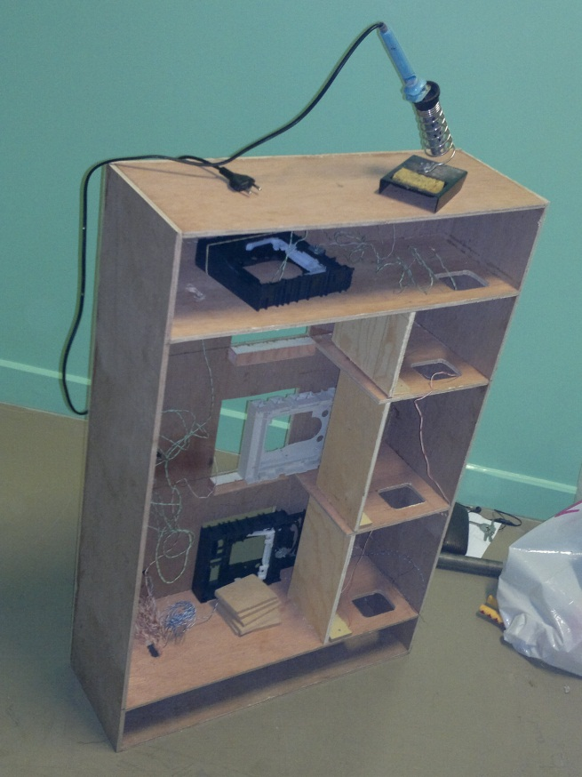
+
=

Slide 14
The Entire Hardware was made from wood.
CD-ROMS were used as doors
Bump sensors were fixed by gluing them to
the edge of the inside of the hardware
Push Buttons were drilled to the
outside of the hardware
The motor was attached to the pulley and
drilled to the top of the hardware

Slide 15
Testing Phase
Wiring was successful
It was discovered that
some wires require an inverter
in the software to function correctly

Slide 16
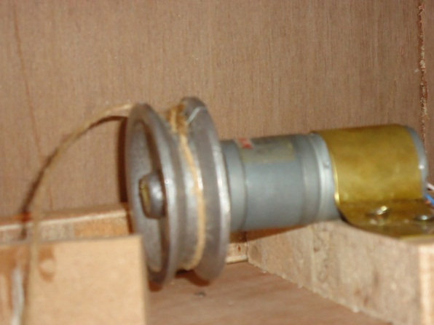
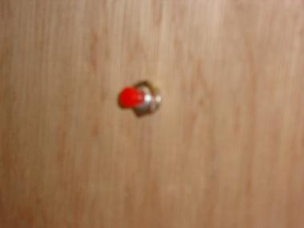
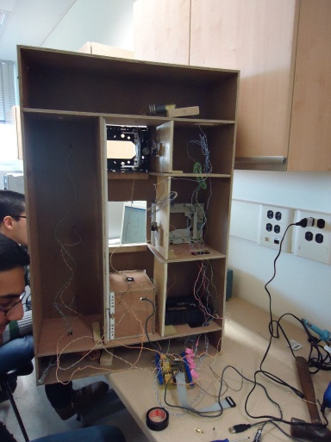
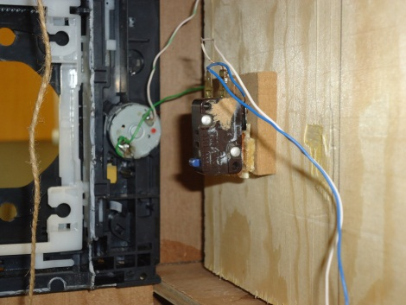
Photo Album

Slide 17
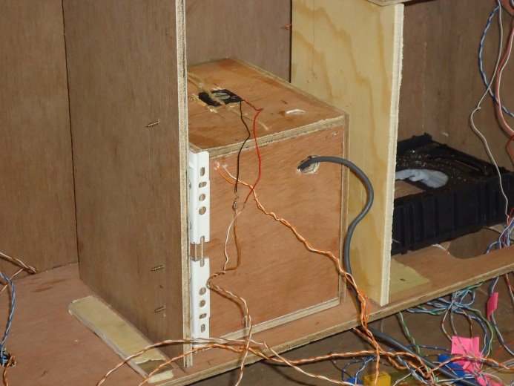
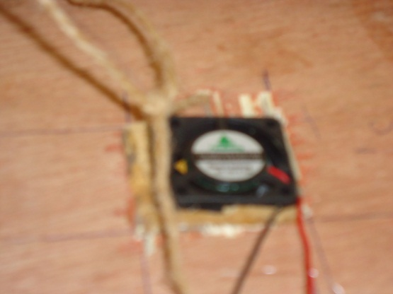
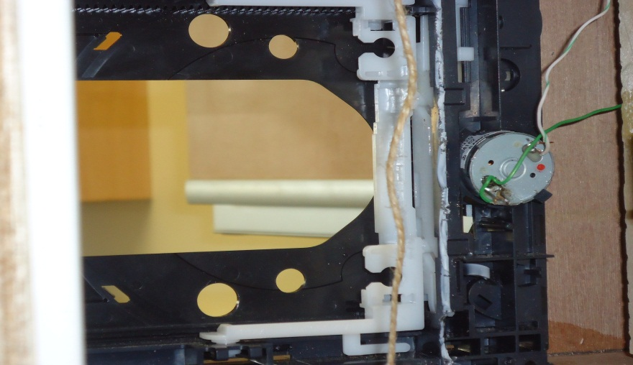
Photo Album

Slide 18
Received Benefits
Learned the value of teamwork,
there is nothing called a successful
engineer but successful engineers

Slide 19
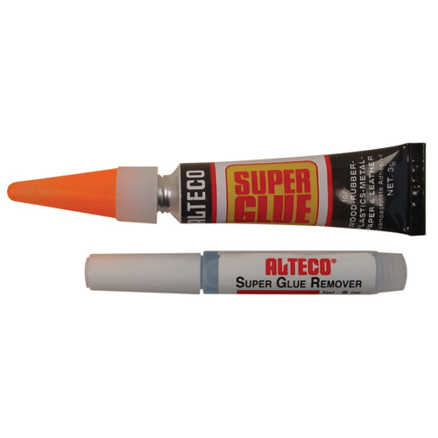
Gained skill (besides programming),
skill of rough work by hand: mending wires,
attaching objects, carpenting…
- Recognized that the facilities we use everyday
are not always as simple as assumed they are!
- Discovered that ALTECO is man’s best friend!

Slide 20
?
Questions
?
?
?
?
?
?
?
?
?
?
?

Slide 21
The
End

